Slide 1
Car Rental & Sale System
Group Members:
Hafiz Muhammad Tariq Raza(18-39)[Data Gathering]
Imran Nazir(18-28) [Data Analysis]
Shahzad Abbas(18-32)[ERD and Relationships]
Saad Rasool(18-38)[Normalization]
Hamza Ahmad(18-52)[Features of Database]
Talha Arshad(18-25)[Data Population]

Slide 2
Scenario
New car is for selling purpose only.
Old car is owned by owners and used for rent purpose only.
Car is rent out with or without driver.
Driver charges vary from car to car.

Slide 3
Data Gathering
Interview
Observation
Web surfing
Personal Experience
Reading Notes

Slide 4
Data Analysis
Identification of Entities & Attributes
Defining Relationship Among Entities
Refining the Relationships

Slide 5
Entities and Attributes
Branch (BranchNo, City, Street, PostCode, ContactNo)
Staff(StaffNo, Fname, Lname, Address, PhoneNo, CNIC, Depart, BankAccount, Position, Salary, Email, Per-Hour-Charge)
Car(CarNo, EngineNo, BodyNo, RegistrationNo, Model, Brand, H-Power, Manufacturer,Category, P-Price, S-Price,O-rent, PerHourCharge, Seats, NOAccidents, EnteringDate, R-CarNo, S-CarNo, Mode)
Client (ClientNo, Name, F-Name, Address, PhoneNo, CNIC)
Invoice(InvoiceNo ,Date, Amount, Discount)
Installment (InstallmentNo, Total-Installments, Per-Install-Period, Per-Install-Amount, Paid-Install)
Owner (OwnerNo, Fname, Lname, Address, PhoneNo, CNIC)
Rental (RentNo, Start-Time, End-Time, Date, Accidental-Charges)

Slide 6
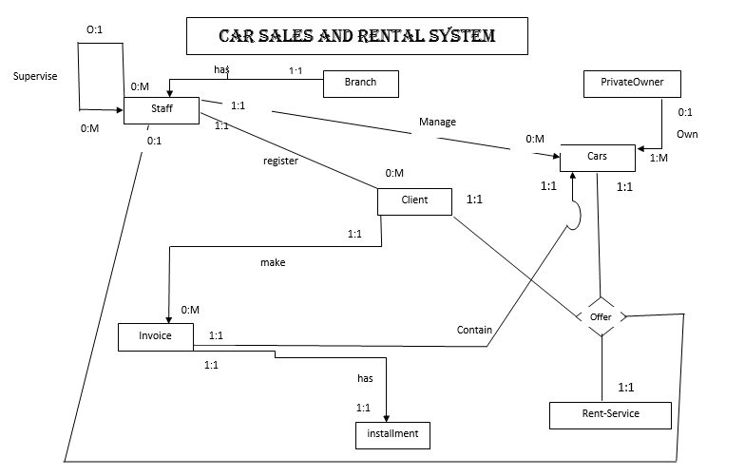

Slide 7
ERD to Relations Conversion
1.
Branch
1:1
Has
0:M
Staff
Branch (BranchNo (P.K), [….])
Staff (StaffNo (P.k), [….], BranchNo(F.K))

Slide 8
2.
Staff
1:1
Register
0:M
Client
Staff (StaffNo(P.k), [….], BranchNo(F.K)
Client (ClientNo(P.k), [….], StaffNo(F.k))

Slide 9
3.
Staff
1:1
Register
0:M
Car
Staff (StaffNo (P.K), [….])
Car (CarNo (P.k), [….], StaffNo(F.K))

Slide 10
4.
PrivateOwner
0:1
own
1:M
Car
PrivateOwner (OwnerNo(P.K), [….])
Car ((CarNo, OwnerNo)(P.k), [….], BranchNo(F.K))

Slide 11
5.
Client
1:1
Make
0:M
Invoice
Client (ClientNo(P.k), [….], StaffNo(F.k)
Invoice (InvoiceNo(P.k), [….], ClientNo(F.k))

Slide 12
6.
Invoice
1:1
Contain
1:1
Car
Car (CarNo(P.k), [….], StaffNo(F.K))
Invoice ((InvoiceNo, CarNo)(P.k), [….] ClientNo (F.k))

Slide 13
7.
Invoice
1:1
Has
1:1
Installment
Invoice ((InvoiceNo, CarNo)(P.k), [….] ClientNo (F.k))
Installment (InstaNo(P.k), [….], InvoiceNo(F.k))

Slide 14
8.
Car
1:1
Offer
Client
1:1
0:1
Staff As Driver
1:1
Rent
Rent ((CarNo, ClientNo, RentNo)(P.k), [….], (StaffNo(F.K))

Slide 15
Tables Before Normalization
Branch (BranchNo (P.K), City, Street, PostCode, ContactNo)
Staff (StaffNo (P.k), Fname, Lname, Address, PhoneNo, CNIC, Depart, BankAccount, Position, Salary, Email, Per-Hour-Charge, BranchNo(F.K))
Car ((CarNo, OwnerNo)(P.k), EngineNo, BodyNo, RegistrationNo, Model, Brand, H-Power, Manufacturer,Category, P-Price, S-Price,O-rent, PerHourCharge, Seats, NOAccidents, EnteringDate, Mode, R-CarNo, S-CarNo, StaffNo(F.K))
Client (ClientNo(P.k), Name, F-Name, Address, PhoneNo, CNIC, StaffNo(F.k))
Invoice (InvoiceNo(P.k), Date, Amount, Discount, (ClientNo, CarNo)(F.k))
Installment (InstaNo(P.k), Total-Installments, Per-Install-Period, Per-Install-Amount, Paid-Install, InvoiceNo(F.k))
PrivateOwner (OwnerNo(P.K), Fname, Lname, Address, PhoneNo, CNIC)
Rent ((CarNo, ClientNo, RentNo)(P.k), Start-Time, End-Time, Date, Accidental-Charges, (StaffNo(F.K))
Note: In car table RegistrationNo will be used to identify Rental Cars & EngineNo + BodyNo will be used to identify Sale cars.

Slide 16
Normalization
First Normal Form
In all tables there is only one value at the intersection of row and column, that’s why all tables are already in 1NF.
Second Normal Form
From previous slide we can see that all tables have Primary Key of single attribute. That’s why there is no Partial Dependency. And we know that if there is no Partial Dependency then the table is in 2NF.

Slide 17
Third Normal Form
In 3NF we deal with transitive dependency. And by observing the tables we know that all tables are free of transitive dependency except Car table.
Car (CarNo (P.k), EngineNo, BodyNo, RegistrationNo, Model, Brand, H-Power, Manufacturer,Category, P-Price, S-Price,O-rent, PerHourCharge, Seats, NOAccidents, EnteringDate, Mode, R-CarNo, S-CarNo StaffNo(F.K))
There are 2 Transitive Dependency in Car.
R-CarNo → O-Rent, OwnerNo, Per-Hour-Charges, NOAccidents
S-CarNo→ S-Price, P-Price

Slide 18
After 3NF
Car (CarNo(P.k), EngineNo, BodyNo, RegistrationNo, Model, Brand, H-Power, Manufacturer, Category, Seats, Mode, EnteringDate, (R-CarNo, S-CarNo StaffNo)(F.K))
R-Car (R-CarNo(P.k), O-Rent, Per-Hour-Charges, NOAccidents, OwnerNo(F.k))
S-Car (S-CarNo(P.k), S-Price, P-Price)

Slide 19
BCNF, 4th, 5th Normal Form
In all relations there is no non primary key attribute that can be determine others, So they are in BCNF.
Similarly no table has any multi-value dependency, that’s why it is in 4th normal form.
All tables satisfy lossless join property that’s why they are also in 5th normal form.

Slide 20
Tables After Normalization
Branch (BranchNo (P.K), City, Street, PostCode, ContactNo)
Staff (StaffNo (P.k), Fname, Lname, Address, PhoneNo, CNIC, Depart, BankAccount, Position, Salary, Email, Per-Hour-Charge, BranchNo(F.K))
Car (CarNo (P.k), EngineNo, BodyNo, RegistrationNo, Model, Brand, H-Power, Manufacturer, Category, Seats, EnteringDate, Mode, (R-CarNo, S-CarNo StaffNo)(F.K))
S-Car (S-CarNo(P.k), P-Price, S-Price)
R-Car (R-CarNo(P.k), O-rent, PerHourCharge, NOAccidents , OwnerNo(F.K))
Client (ClientNo(P.k), Name, F-Name, Address, PhoneNo, CNIC, StaffNo(F.k))
Invoice (InvoiceNo(P.k), Date, Amount, Discount, (ClientNo, CarNo)(F.k))
Installment (InstaNo(P.k), Total-Installments, Per-Install-Period, Per-Install-Amount, Paid-Install, InvoiceNo(F.k))
PrivateOwner (OwnerNo(P.K), Fname, Lname, Address, PhoneNo, CNIC)
Rent ((CarNo, ClientNo, RentNo)(P.k), Start-Time, End-Time, Date, Accidental-Charges, (StaffNo(F.K))

Slide 21
Features Of DBMS (MS Access)
Data Dictionary
Report Generator
Access Security
Backup And Recovery

Slide 22
Data Dictionary
Data Dictionary is a file that is used to store data definition or description of the data structure in database.
It may also monitor the data that is entered.
It ensure that data is according to the data definition rule.
The Rule include field name, field size, and data types etc.

Slide 23
Report Generator
A Report generator is a program that is used to produce report.
It retrieve data from database and display the data it In different formats.
The User can produce useful and attractive reports by using different report generator

Slide 24
Access Security
Access security refers to the protection of database from unauthorized access.
The database management system provide several procedure to maintain data security.
The security is maintained by allowing access to the database through the use of password.

Slide 25
Backup and Recovery
Database Management System Provide the Facility for Backup and Recovery.
Backup and Recovery facility is used to store an additional copy of data.
The data can be recovered if the original file lost or damaged.

